Slide 1

Telangana Weather Data Analysis
Presented by:
N.Sahaja Reddy
Batch No.514

Slide 2
About me
N.Sahaja Reddy
Background
B.Tech in Computer Science Engineering from Narsimha Reddy Engineering College
Why you want to learn Data Analytics
I choose Data Analytics because I like working with data and finding useful insights.
Linkedin
Github

Slide 3
Agenda
Introduction
Problem Statement
Project Objectives
Dataset Description
Tools & Technologies
Data Preparation
Rainfall Analysis Dashboard
Temperature Insights Dashboard
Humidity Patterns Dashboard
Wind Speed Analysis Dashboard
Comprehensive Weather Insights
Key Findings
Future Scope
Conclusion
Questions & Answers

Slide 4
Introduction
Weather analysis is essential for understanding climate conditions and supporting better planning in agriculture, disaster management, transportation, and water resource management.
This project uses Power BI to transform raw weather data into interactive dashboards.
By analyzing rainfall, temperature, humidity, and wind speed, users can easily identify trends, seasonal changes, and district-wise weather patterns through visual reports.
Analyzing weather conditions helps identify trends, seasonal variations, and extreme weather events across different regions.
This dashboard presents weather information in a clear and interactive format using Power BI visualizations and DAX measures.

Slide 5
Problem Statement
Weather data is available in large volumes and is difficult to interpret manually.
Comparing weather conditions across districts and years is time-consuming.
Traditional reports lack interactive analysis.
Decision-makers need a dashboard to monitor weather trends and detect unusual weather events quickly.

Slide 6
Project Objectives
Analyze rainfall, temperature, humidity, and wind speed.
Compare weather conditions across districts and mandals.
Identify seasonal weather patterns.
Detect extreme weather events and anomalies.
Create interactive dashboards with filters and slicers.
Provide meaningful insights through data visualization.

Slide 7
Dataset Description
Dataset Overview: The dataset contains daily weather observations collected for multiple districts and mandals.
Attributes:
Date
District
Mandal
Rainfall(mm)
Temperature
Humidity
Wind Speed
Years Included:
2021
2022
2023
2024

Slide 8
Tools & Technologies
Tools Used:
Power BI
Used to create dashboards, reports, and interactive visualizations.
Power Query
Used for importing, cleaning, and transforming data.
DAX
Used to calculate KPIs, averages, totals, rankings, and custom measures.
Excel/CSV
Used as the source format for weather datasets.

Slide 9
Data Preprocessing
Data Cleaning & Preparation
Before creating dashboards, the dataset was cleaned using Power Query.
Steps Performed
Imported multiple yearly datasets.
Combined all years into a single dataset.
Removed duplicate records.
Replaced null values.
Corrected data types.
Created Year, Month, and Season columns.
Verified data consistency.

Slide 10
Rainfall Analysis Dashboard
Rainfall Analysis
This dashboard focuses on rainfall patterns across districts.
Key Insights
District with the highest average rainfall.
Monthly rainfall trends.
Seasonal rainfall analysis.
Annual rainfall comparison.
Rainfall intensity by district.
Detection of rainfall anomalies.
Monthly rainfall contribution percentage.

Slide 11
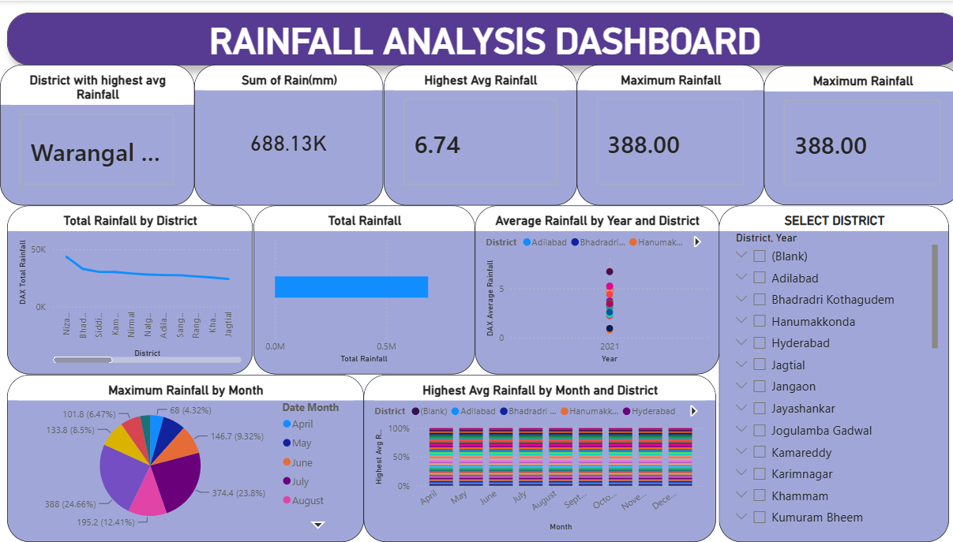

Slide 12
Temperature Insights Dashboard
Temperature Insights
This dashboard provides detailed temperature analysis.
Key Insights
Average minimum and maximum temperatures.
Daily temperature range.
Seasonal temperature changes.
Extreme temperature periods.
District-wise comparison.
Temperature distribution throughout the year.
Temperature trend analysis.

Slide 13
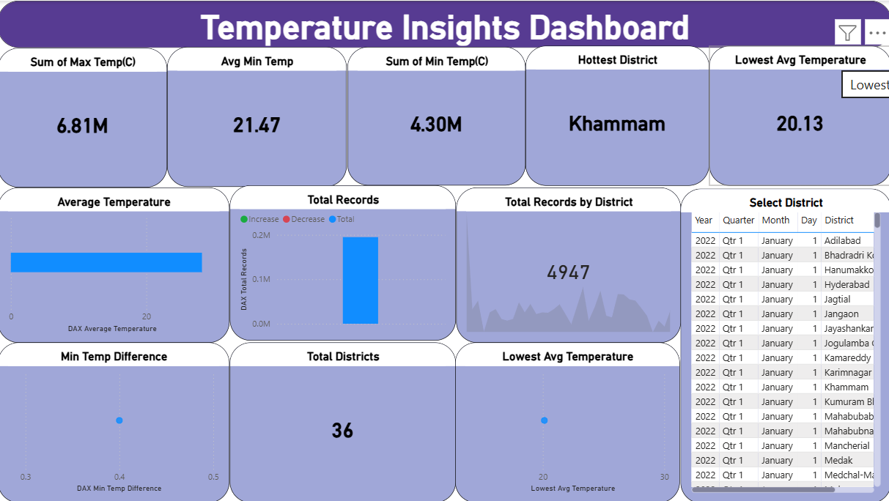

Slide 14
Humidity Patterns Dashboard
Humidity Analysis
The dashboard helps understand humidity variations.
Key Insights
Average humidity across districts.
Seasonal humidity changes.
Daily humidity range.
Humidity distribution.
Extreme humidity periods.
Comparison between districts.
Detection of humidity anomalies.

Slide 15
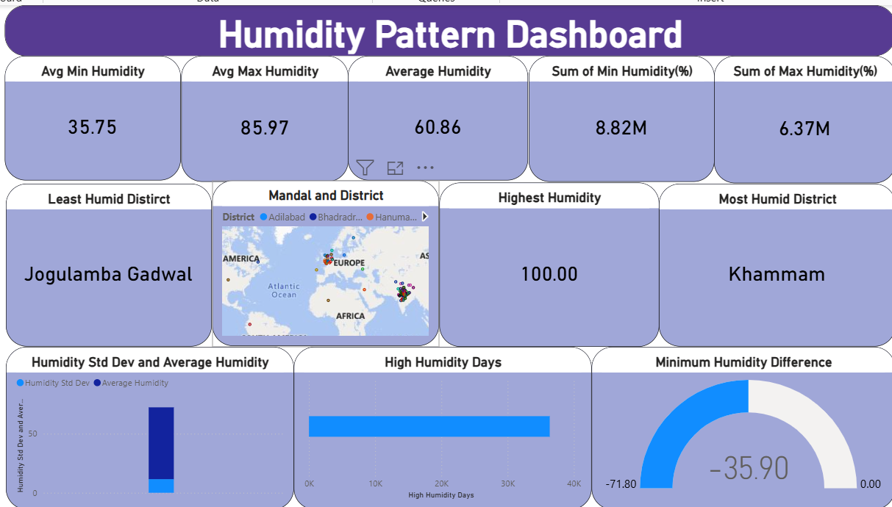

Slide 16
Wind Speed Analysis Dashboard
Wind Speed Analysis
This dashboard analyzes wind speed variations across districts.
Key Insights
Average wind speed.
Daily wind speed range.
Maximum and minimum wind speeds.
Wind speed distribution.
Seasonal wind patterns.
Extreme wind events.
District comparison.

Slide 17
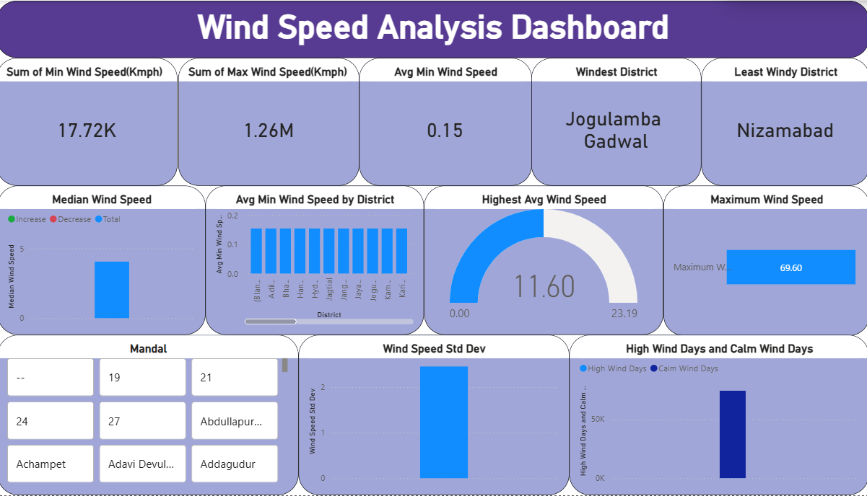

Slide 18
Comprehensive Weather Dashboard
Comprehensive Weather Insights
This dashboard combines all weather parameters into one report.
Includes
Rainfall analysis
Temperature analysis
Humidity analysis
Wind speed analysis
Weather trends
Seasonal analysis
District comparison
Interactive filters and slicers

Slide 19
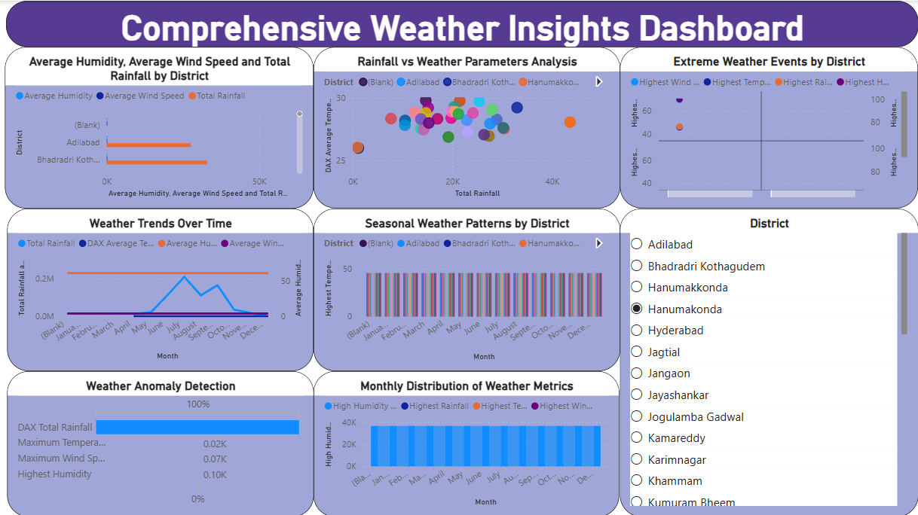

Slide 20
Power BI Visualizations Used
Visualizations
The dashboard uses multiple visualizations to improve analysis.
Visuals Used
KPI Cards
Line Charts
Clustered Bar Charts
Column Charts
Scatter Charts
Filled Maps
Matrix
Slicers
Tables
Filters
These visuals help users analyze data efficiently and interactively.

Slide 21
Key Findings
Project Findings
Rainfall varies significantly across districts.
Temperature is highest during the summer season.
Humidity increases during the monsoon season.
Wind speed changes depending on the season and district.
Interactive dashboards simplify weather monitoring.
DAX measures provide dynamic and real-time calculations.
Visual reports make decision-making easier.

Slide 22
Future Scope
Future Enhancements
Integrate live weather APIs.
Add weather forecasting using Machine Learning.
Build mobile-friendly dashboards.
Include air quality and pollution data.
Enable real-time weather alerts.
Publish dashboards on the Power BI Service for online access.

Slide 23
Conclusion
This project demonstrates how Power BI can be used to transform raw weather data into meaningful visual insights.
By analyzing rainfall, temperature, humidity, and wind speed, the dashboard helps identify trends, compare districts, and detect unusual weather events.
The use of DAX, Power Query, and interactive visualizations makes the analysis accurate, efficient, and user-friendly.

Slide 24


Slide 25

THANK YOU

